Slide 1

AI-Assisted Lung Cancer Detection
Bridging Deep Learning Performance with Clinical & Business Impact
Authors
Institution
AI & Deep Learning: Dumitrascu Constantin Alexandru
Babeș-Bolyai University
Course: MIRPR & PPI
Application, Business & Product Design: Gatea David, Manta Andrei Dragos, Craciunoiu Denis-Andrei
Academic Year: 2025–2026

Slide 2

SECTION 1
AI & Technical Overview
Our presentation is divided into two key sections, ensuring a comprehensive understanding of both the technical innovation and its real-world application.
1
AI & Technical
Focuses on the deep learning models and their performance in lung cancer detection.
2
Business, Product & Market
Explores the practical deployment, market impact, and strategic considerations.

Slide 3





AI & TECHNICAL
Problem & Motivation
Leading Cause
Lung cancer is the leading cause of cancer deaths globally.
Early Detection
Dramatically improves survival rates for patients.
Radiologist Shortage
A critical need for AI assistance to support medical professionals.
AI as Support
AI acts as decision support, not a replacement for human expertise.

Slide 4
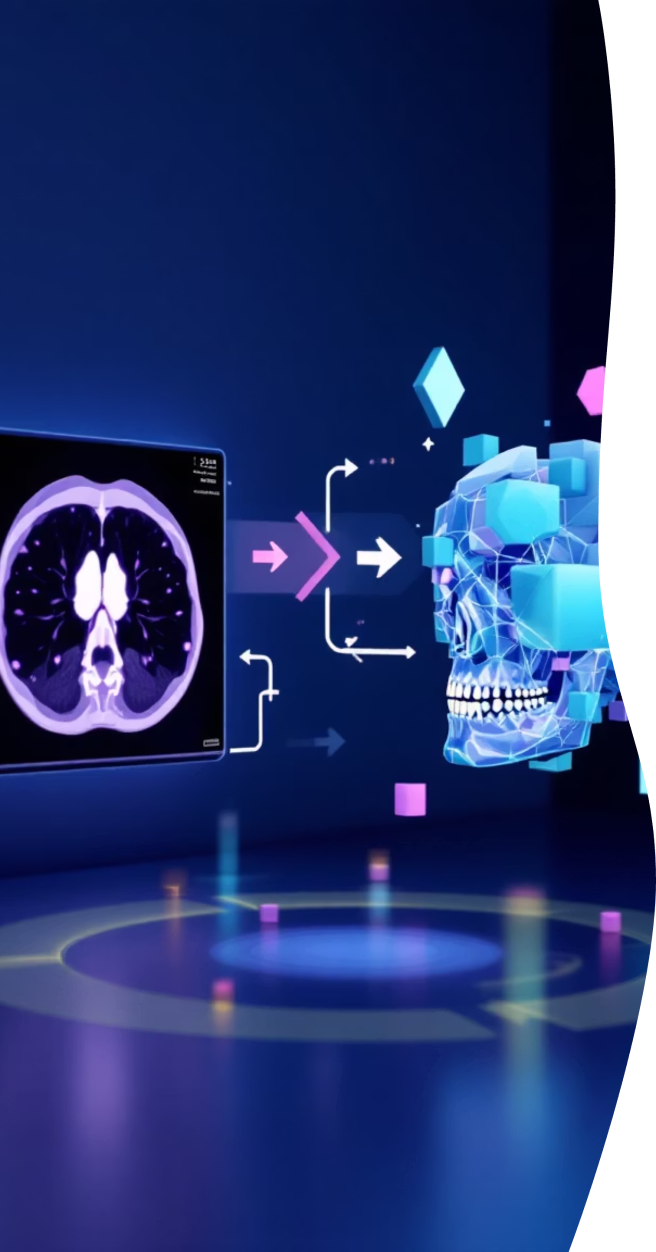



AI & TECHNICAL
AI Pipeline Overview
Our system integrates multiple AI steps for comprehensive lung cancer screening.
2D X-ray Screening
Fast, cost-effective initial assessment.
Nodule Localization
YOLO model identifies potential nodules.
3D CT Diagnosis
High-confidence confirmation using detailed scans.

Slide 5

AI & TECHNICAL
AI Takeaways
1
Grayscale Superiority
Optimal for 2D medical imaging tasks.
2
Detection Complexity
More challenging than classification, requiring specialized models.
3
3D Native Architectures
Crucial for accurate and high-confidence diagnoses.
4
Consumer Hardware
Achieved research-level results, making deployment accessible.

Slide 6

SECTION 2
The Real-World Problem: Romania
Lung cancer poses a significant health challenge in Romania, exacerbated by limited medical resources.
High Incidence
~11,716 new lung cancer cases annually.
High Mortality
~10,000+ deaths each year.
Pneumonologist shortage
~983 pulmonologists holding valid licenses in 2020
Diagnostic Gap
~7 counties offer full diagnostics

Slide 7

BUSINESS, PRODUCT & MARKET
Product Vision: AI-Assisted Screening Platform
Our platform is designed to empower doctors with efficient and accurate lung cancer screening.
01
AI Supports Doctors
Enhances capabilities, does not replace human expertise.
02
Fast Screening
Quick initial assessment with AI risk scores.
03
High-Confidence CT
Detailed analysis for confirmed diagnoses.
04
Existing Hardware
Compatible with current hospital infrastructure.

Slide 8

BUSINESS, PRODUCT & MARKET
Business Impact & Conclusion
Our AI solution offers significant market potential and life-saving benefits.
40+
$400M
Oncology Departments
Health Digitalization
Market
Target market for deployment.
Projected growth by 2028.
Combining strong AI performance with a realistic business strategy makes AI-assisted lung cancer detection technically feasible and clinically valuable today.

